Slide 1






‘Closer, not further away’: engagement, inclusion and virtual education
.
Nisai Learning is the first online education provider in the UK to win a government innovation grant, a Knowledge Transfer Partnership (KTP), with Staffordshire University - awarded by UK Research & Innovation (UKRI).
Nisai Learning secured government research funding due to its track record – 25 years of delivering high quality online and blending education to thousands of the most vulnerable and hard to reach young people in our communities.
Integral to that track record has been consistent data capture, and a willingness to reflect on practice and then innovate in both pedagogy and technical delivery – key attributes for a KTP programme.
The KTP is managed by Nisai Education Trust - a charity established specifically to undertake research into innovation in online and blended education

Slide 3
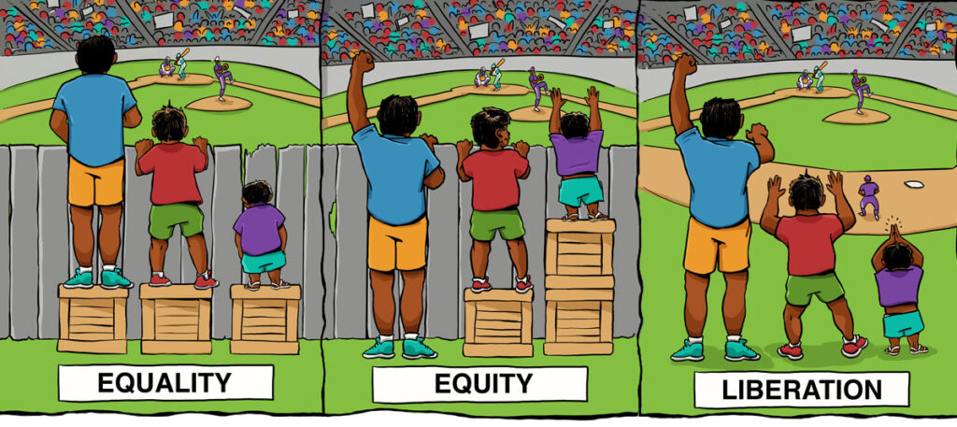

Slide 4

The Nisai Knowledge Transfer Partnership with Staffordshire University, UK
The 2.5-year project is about evidencing how schools and providers can use online education to support vulnerable and marginalised learners to re-integrate into mainstream education, employment and training.
identifying the most effective non-traditional learning models that meet the needs of learners outside of ‘mainstream’ education systems
utilising best practice in educational research to analyse learner impact data and trends in the use of online education
using the research data to inform the design of online/blended programme & pedagogy
providing evidence of the economic benefits of supporting vulnerable and marginalised learners through non-traditional forms of education
Researcher - Dr Charlotte Fearn, Staffordshire University
PI - Dr Jim Pugh, Director of the Institute of Education, Staffordshire University

Slide 5
What ‘barriers’ to re-integration (or inequality!) do the
young people in this cohort face?
EHCP | 528 | 16%
Mental health | 525 | 16%
Emotional | 513 | 16%
ASD | 392 | 12%
Medical | 274 | 9%
Behavioural | 245 | 8%
School Refuser | 239 | 7%
Learning | 125 | 4%
No school placement | 100 | 3%
Excluded | 88 | 3%
LAC | 76 | 2%
Bullied | 52 | 2%
Developmental | 45 | 1%
Total | 3202 | 100%
"Barriers in registration notes" are based on a key word search in background notes provided by school or LA at the point of registration.
Anxiety | 400 | 56%
ADHD | 87 | 12%
Sleep issues | 76 | 11%
Self harm | 55 | 8%
ODD | 36 | 5%
OCD | 33 | 5%
Eating disorder | 23 | 3%
Total | 710 | 100%
Note: Student barriers are given by school or LA at the point of registration.

Slide 6
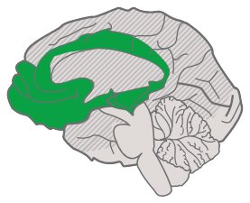
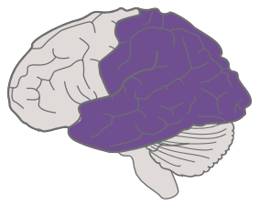
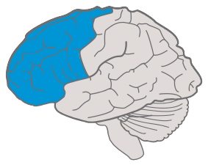








Looking at the research outcomes through the lens of UDL v3
 | Design Multiple Means of Engagement | Design Multiple Means of Representation | Design Multiple Means of Action & Expression
Access | Design Options for Welcoming Interests & Identities Optimize choice and autonomy Optimize relevance, value, and authenticity Nurture joy and play Address biases, threats, and distractions | Design Options for Perception Support opportunities to customize the display of information Support multiple ways to perceive information Represent a diversity of perspectives and identities in authentic ways | Design Options for Interaction Vary and honor the methods for response, navigation, and movement Optimize access to accessible materials and assistive and accessible technologies and tools
Support | Design Options for Sustaining Effort & Persistence Clarify the meaning and purpose of goals Optimize challenge and support Foster collaboration, interdependence, and collective learning Foster belonging and community Offer action-oriented feedback | Design Options for Language & Symbols Clarify vocabulary, symbols, and language structures Support decoding of text, mathematical notation, and symbols Cultivate understanding and respect across languages and dialects Address biases in the use of language and symbols Illustrate through multiple media | Design Options for Expression & Communication Use multiple media for communication Use multiple tools for construction, composition, and creativity Build fluencies with graduated support for practice and performance Address biases related to modes of expression and communication
Executve Functon | Design Options for Emotional Capacity Recognize expectations, beliefs, and motivations Develop awareness of self and others Promote individual and collective reflection Cultivate empathy and restorative practices | Design Options for Building Knowledge Connect prior knowledge to new learning Highlight and explore patterns, critical features, big ideas, and relationships Cultivate multiple ways of knowing and making meaning Maximize transfer and generalization | Design Options for Strategy Development Set meaningful goals Anticipate and plan for challenges Organize information and resources Enhance capacity for monitoring progress Challenge exclusionary practices
udlguidelines.cast.org © CAST, Inc. 2024 Suggested Citation: CAST (2024). Universal Design for Learning Guidelines version 3.0 [graphic organizer]. Lynnfield, MA: Author.

Slide 7
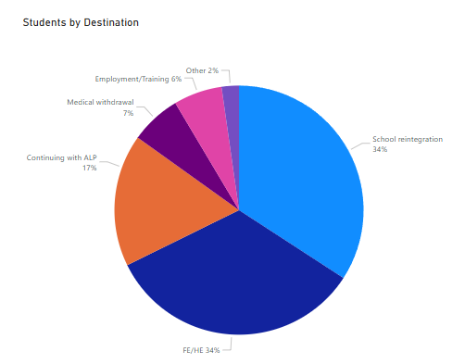
School reintegration | 380 | 34%
FE/HE | 373 | 34%
Continuing with ALP | 191 | 17%
Medical withdrawal | 73 | 7%
Employment/Training | 70 | 6%
Other | 25 | 2%
Total | 1112 | 100%

Slide 8
What have we found impacts on re-integration into positive destinations – what makes the difference.
Engagement rate over all activities is over 40%
3.30x
Average of unauthorised absence is 19% or less
1.64x
Task completion is 32% higher than the cohort average
1.41x
Programme has face-to-face mentoring
1.40x
There is more than one learner from the school/LA
1.38x
The learner is Post16
1.35x
The learner is an LA referral
1.27x

Slide 9

What the research shows impacts on re-integration into positive destinations – 3 key areas for investigation…
1. The importance of the engagement of commissioners in ensuring an effective pathway into the programme but also a pathway back into a positive destination – mitigating against a ‘cliff-edge’
2. The positive impact that a ‘blended’ (on/off-line) programme has on the learner, and in particular, the role of a face-face mentor in supporting engagement and transition (in terms of research the focus here will be on Nisai’s post 16 Personalised Learning and Support Programme).
3. The overall levels of learner engagement. Not just in lessons but also in the programme as a whole: having high levels of attendance, undertaking extension activities, assignments, personal development opportunities, impactful CEIAG . From our first look through of the data the online pastoral input and the student support team have the greatest impact on achieving a positive destination.

Slide 11
Next steps
Work with online teachers, the virtual academy’s pastoral support team and face-to-face mentors in ‘digging into’ the 3 impacting factors by ‘emphasizing learners' multiple and intersecting identities… and acknowledging individual, institutional, and system level barriers as part of variability’ (CAST 2024), specifically:
‘Engagement
Centering, affirming, and sustaining learners’ interests and identities
Emphasizing the role of belonging in teaching and learning
Promoting the role of joy and play for learners and educators alike
Cultivating empathy and repairing harm with restorative practices
Representation
Authentically representing a diversity of identities, perspectives, and narratives as they relate to learners
Considering perceptions of people, cultures, and languages
Valuing multiple ways of knowing and making meaning
Action and Expression
Honoring and valuing a wide variety of forms of communication
Centering and valuing forms of expression that have been overlooked or ignored by addressing biases
Challenging exclusionary practices to build more accessible, inclusive spaces and system’

Slide 12
Get in touch with the project
www.nisai.com/net/
paul.keenleyside@nisai.com
charlotte.fear@nnisai.com

